Slide 1
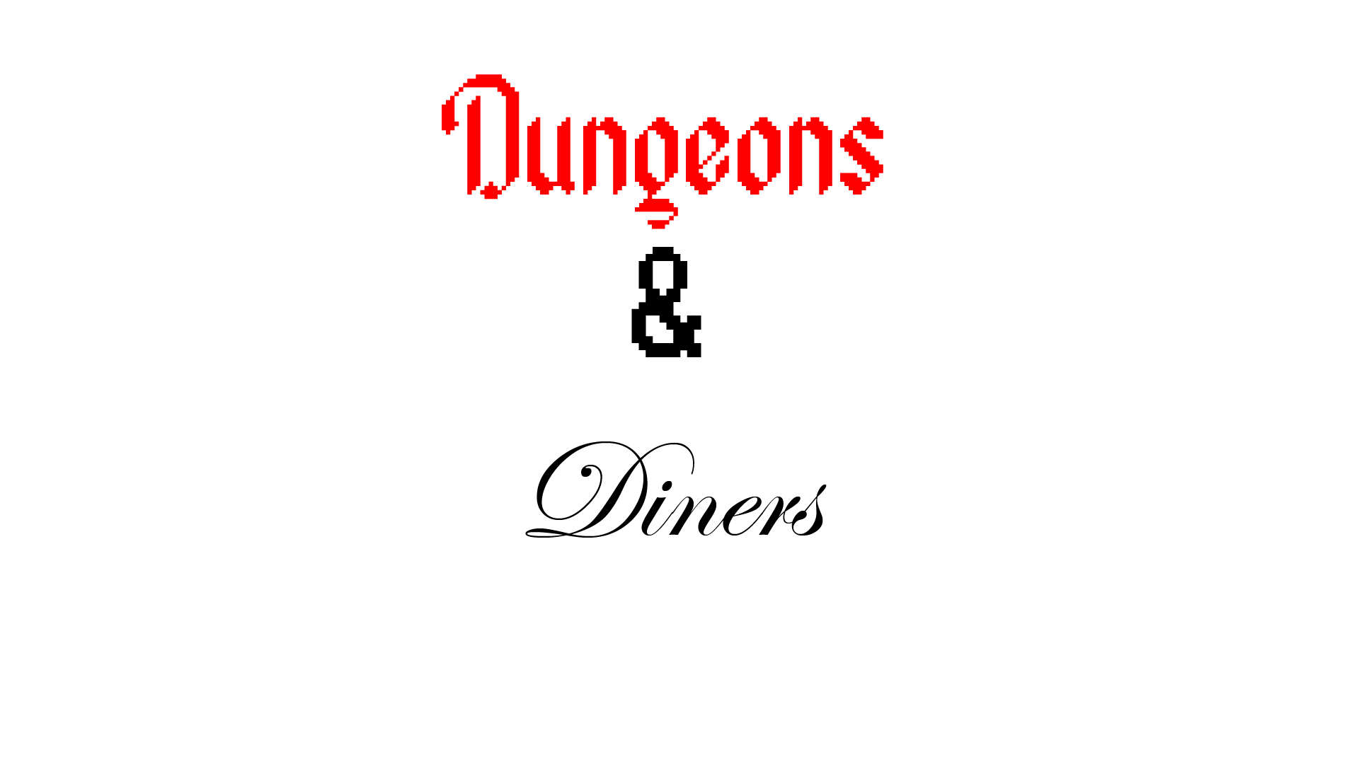
Group 1

Slide 2
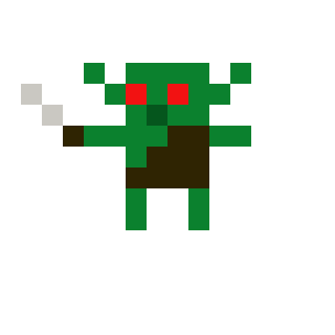
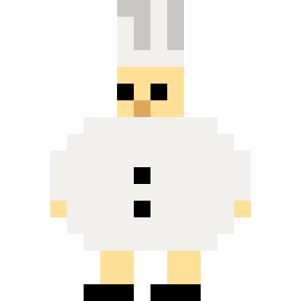
Setting
You play as a chef in a fantasy world that is sick of getting all his ingredients second hand from adventurers so he buys a licence and heads into the dungeon where he will fight monsters like orcs and goblins
Will be 16 bit top down, The maps will be grid based so the player/mobs will move 1 square each turn
<-- Design of the Goblin
Design of the main character -->

Slide 3
Games we were inspired by.
Zelda
Binding of issac
Hades
City skylines

Slide 4
Mechanics
Tycoon aspects – upgrading your restaurant (E.g. buying new furniture and tools for cooking)
Money can only be earned from the food you sell in the restaurant
Money can also be used to purchase weapons (The weapons available will depend on the level of the dungeon you are at)
You need to pay to get into the lower levels of the dungeon
There is no healing, when you die in the dungeon you are forced back to the restaurant with only half of what you collected
Each floor will have a specific metal assigned to it
The metals found in the dungeon will be used to upgrade tools in the kitchen
The money earned from the restaurant will be used to upgrade dungeon tools
Weapons will be blades found in the kitchen (Butcher knife, kitchen knife, butter knife)

Slide 5
Enemies
Snake (movement patterns)
Environmental traps (E.G. spikes, …)
Goblins (are in packs, mix of rangers and melee)
Orc (Stronger version of goblins in smaller packs)
Ogres (Will move toward the player if they’re within a radius, Mini boss)
Mimics (Fake chests will deal damage if interacted with and will not be able to be killed if interacted with, will be a 1 hit kill that gives a reward if the player notices it’s a mimic)
Cyclops (Floor boss)

Slide 6
credits
programming - Sean
Art - Jac
sound design - Kaf

